Slide 1
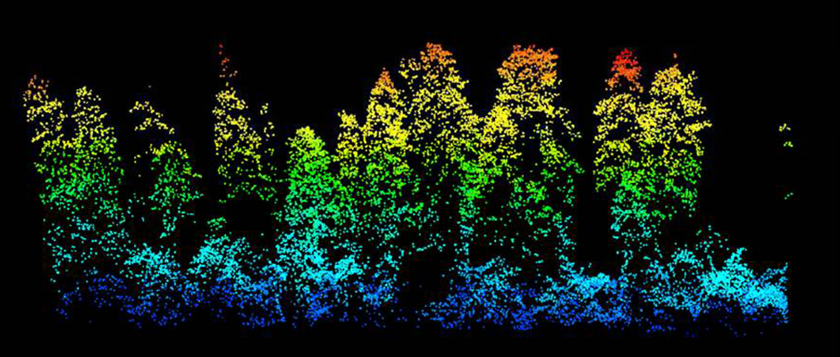
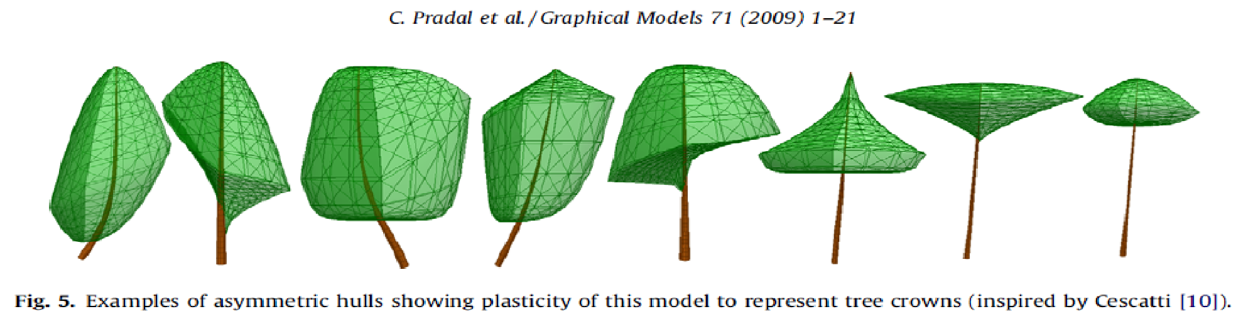
forest3d
David Diaz, Martin Bagaram, Zhehao Li
wildlife.org

Slide 2
PROJECT GOAL
forest3d
Misalignment between remotely-sensed data and ground-based measurements introduces error in models used for predicting and monitoring forest conditions.
This project was designed to use 3D modeling, visualization, and optimization to co-register ground-based forest measurements with a lidar point cloud.
Tree List
Point Cloud
3D Model
3D Mesh
Optimization
Co-Registered Tree List

Slide 3
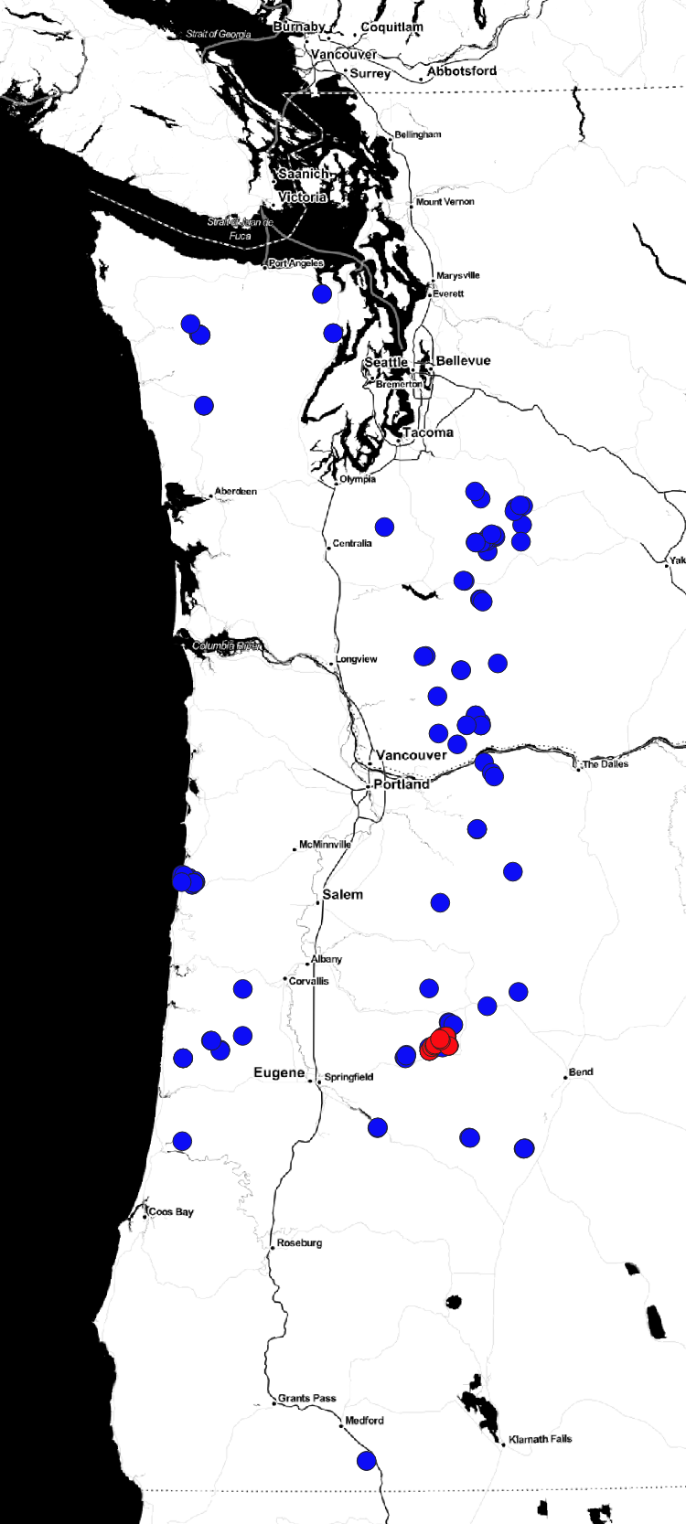
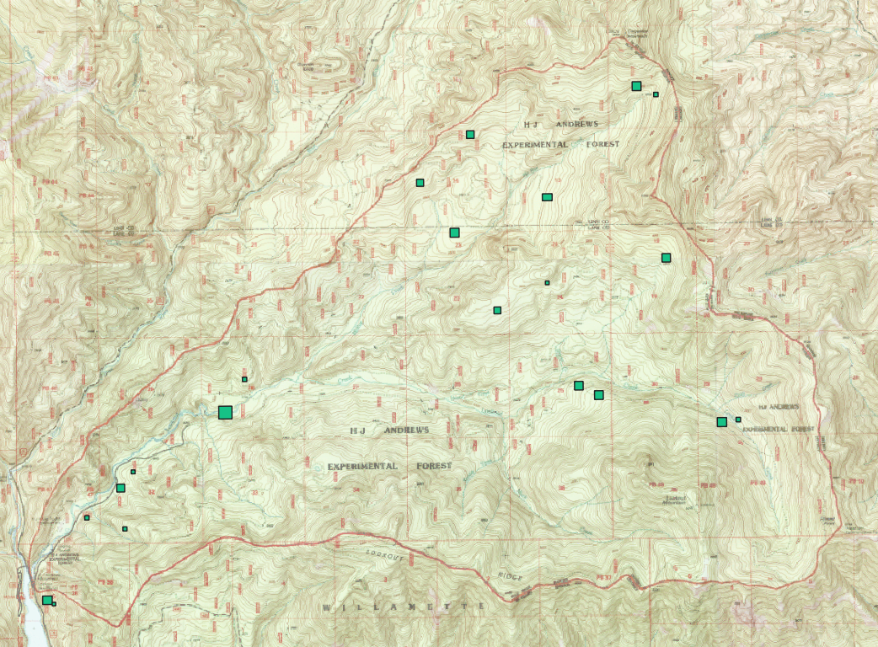
Tree Lists
Datasets
Text files containing measurements from ecological research sites with tree locations, size, species, etc.

Slide 4
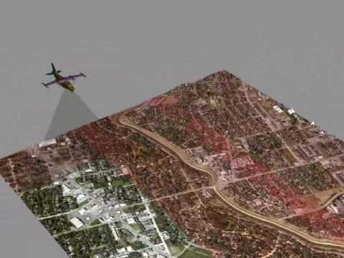
Lidar Point Clouds
Datasets

Slide 5
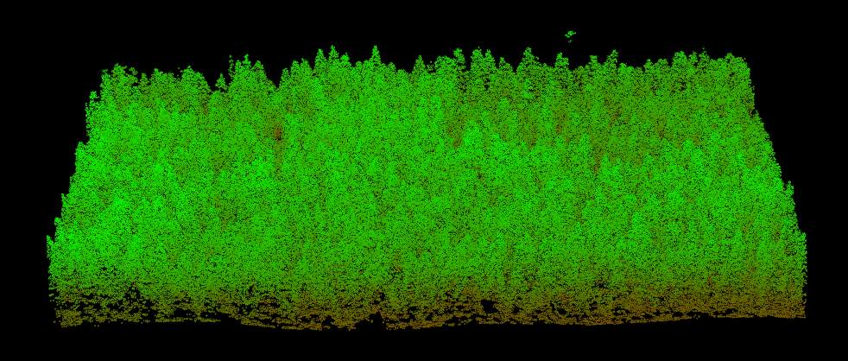
Lidar Point Clouds
Datasets
Lidar from HJ Andrews and Wind River Experimental Forests where stem maps (tree lists) have also been collected.
This is a 12-hectare plot (300x400m) at Wind River where 6,000+ trees have been measured repeatedly.

Slide 6

Functional Requirements
USER PROFILE
Forest Manager
or Analyst
Knows common tree measurements
Intuition for reasonable tree shapes and sizes
Not a programmer, but able to execute Jupyter Notebook with instruction (if installation of computing environment handled for them).

Slide 7




Functional Requirements
USE CASES
Check tree list format
Inspect tree model
Visualize tree list
Co-registration

Slide 8
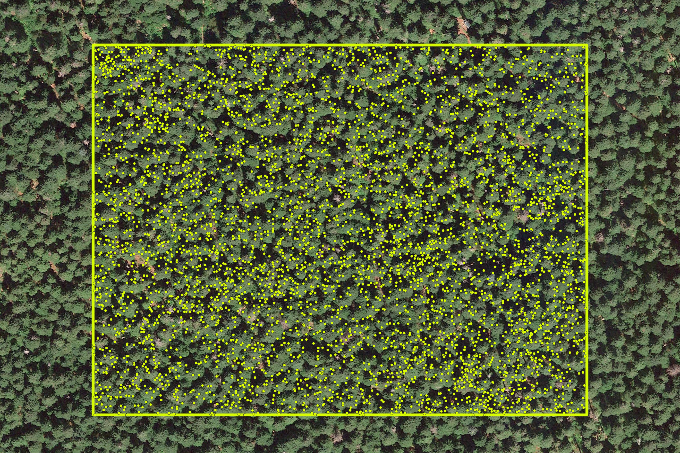
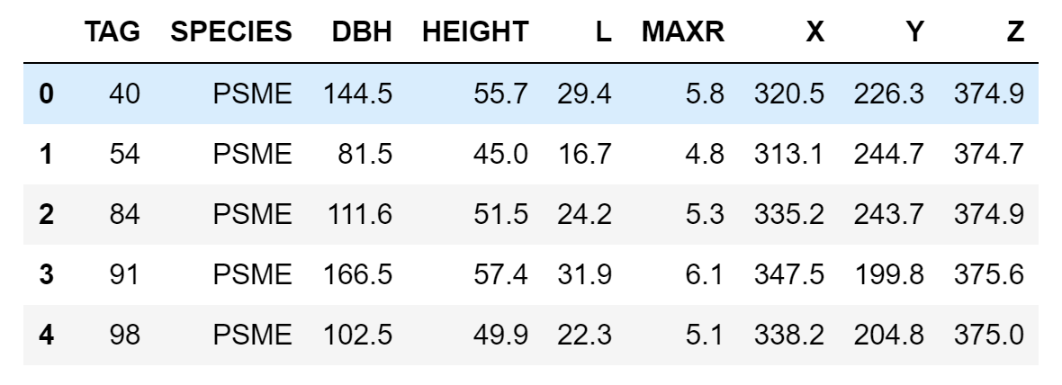
Component Specifications
TREE LIST PROCESSING
1. Georeferencing and data format validation
In [1]: from forest3d.validate_data import tree_list_checker
In [2]: tree_list_checker(‘my_treelist.shp’)
Out[2]: True
Text file
Shape file

Slide 9
Component Specifications
TREE LIST PROCESSING
2. Visualizing a single tree
In [1]: from forest3d.visualize import plot_tree_with_widget
In [2]: plot_tree_with_widget()
3. Visualizing a list of trees
In [1]: from forest3d.visualize import plot_tree_list
In [2]: plot_tree_list(‘my_tree_list.shp’)

Slide 10
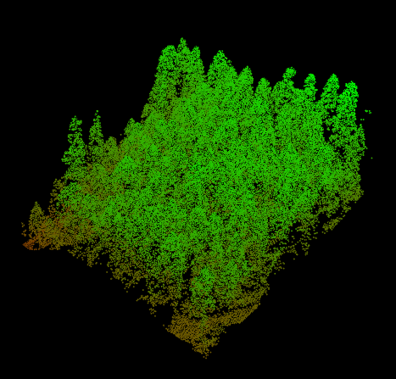
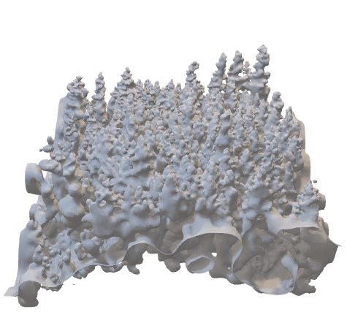
Component Specifications
POINT CLOUD PROCESSING
1. Make mesh from point cloud
In [1]: from forest3d.geometry import make_mesh
In [2]: make_mesh(‘point_cloud.laz’, ‘mesh.ply’)
point_cloud.laz
mesh.ply

Slide 11
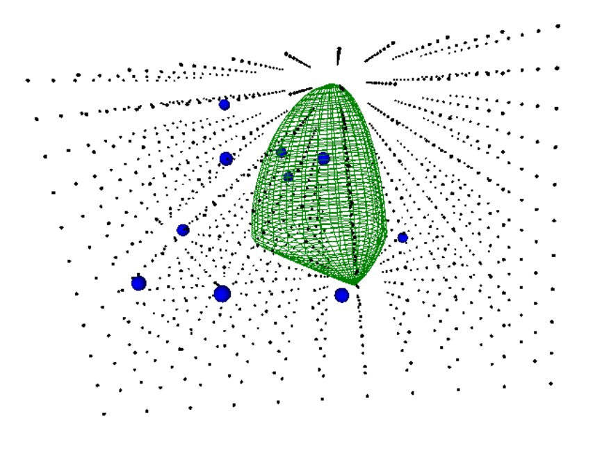
Component Specifications
POINT CLOUD PROCESSING
2. Calculate distance from mesh to 3D grid points
Mesh re-organized as a scipy.spatial.cKDTree
Each grid point is queried to calculate distance to nearest neighbor point in the mesh.
Distances of new query points from mesh can now be estimated rapidly through scipy.interpolate. RegularGridInterpolator

Slide 12
CHECK IT OUT FOR YOURSELF
Code on GitHub
Docs hosted at Read the Docs
Continuous Integration using Travis CI
90% test coverage with Coveralls

Slide 13
WHAT’S COMING NEXT
Loading PLY meshes as numpy arrays
Scripting the grid/mesh distance function
Specifying prior distributions for tree parameters
Trying several optimization algorithms to minimize distance between simulated crowns and lidar-derived mesh.

Slide 14
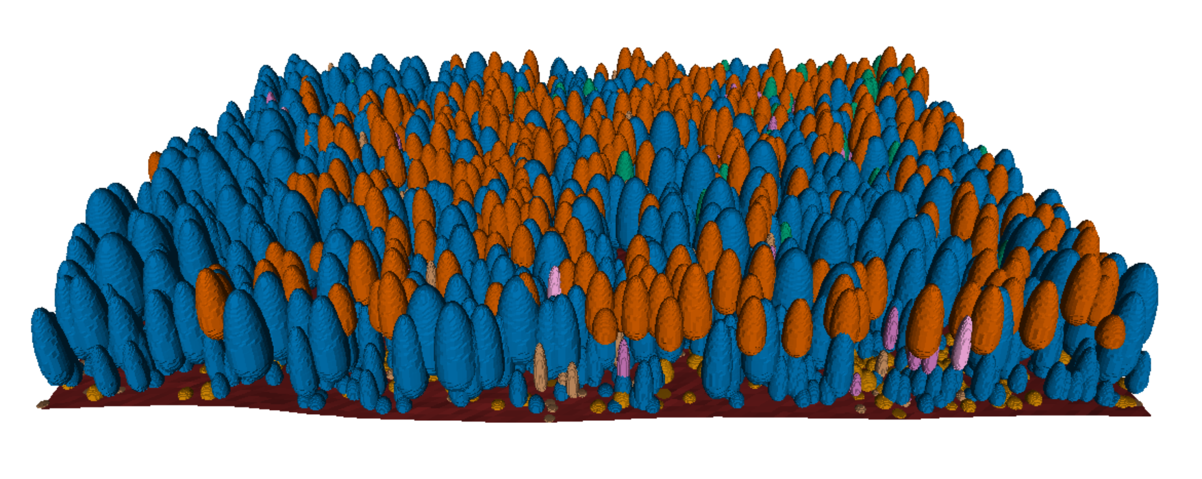
forest3d
THANK YOU!
David Diaz, Martin Bagaram, Zhehao Li

